Slide 1


SMART INDIA HACKATHON 2024
TITLE PAGE
Problem Statement ID – SIH1700
Problem Statement Title- Developing an AI based interactive Chatbot or virtual assistant for the Department of Justice’s Website
PS Category- Software
Team Name (Registered on portal): pip_install_error

Slide 2
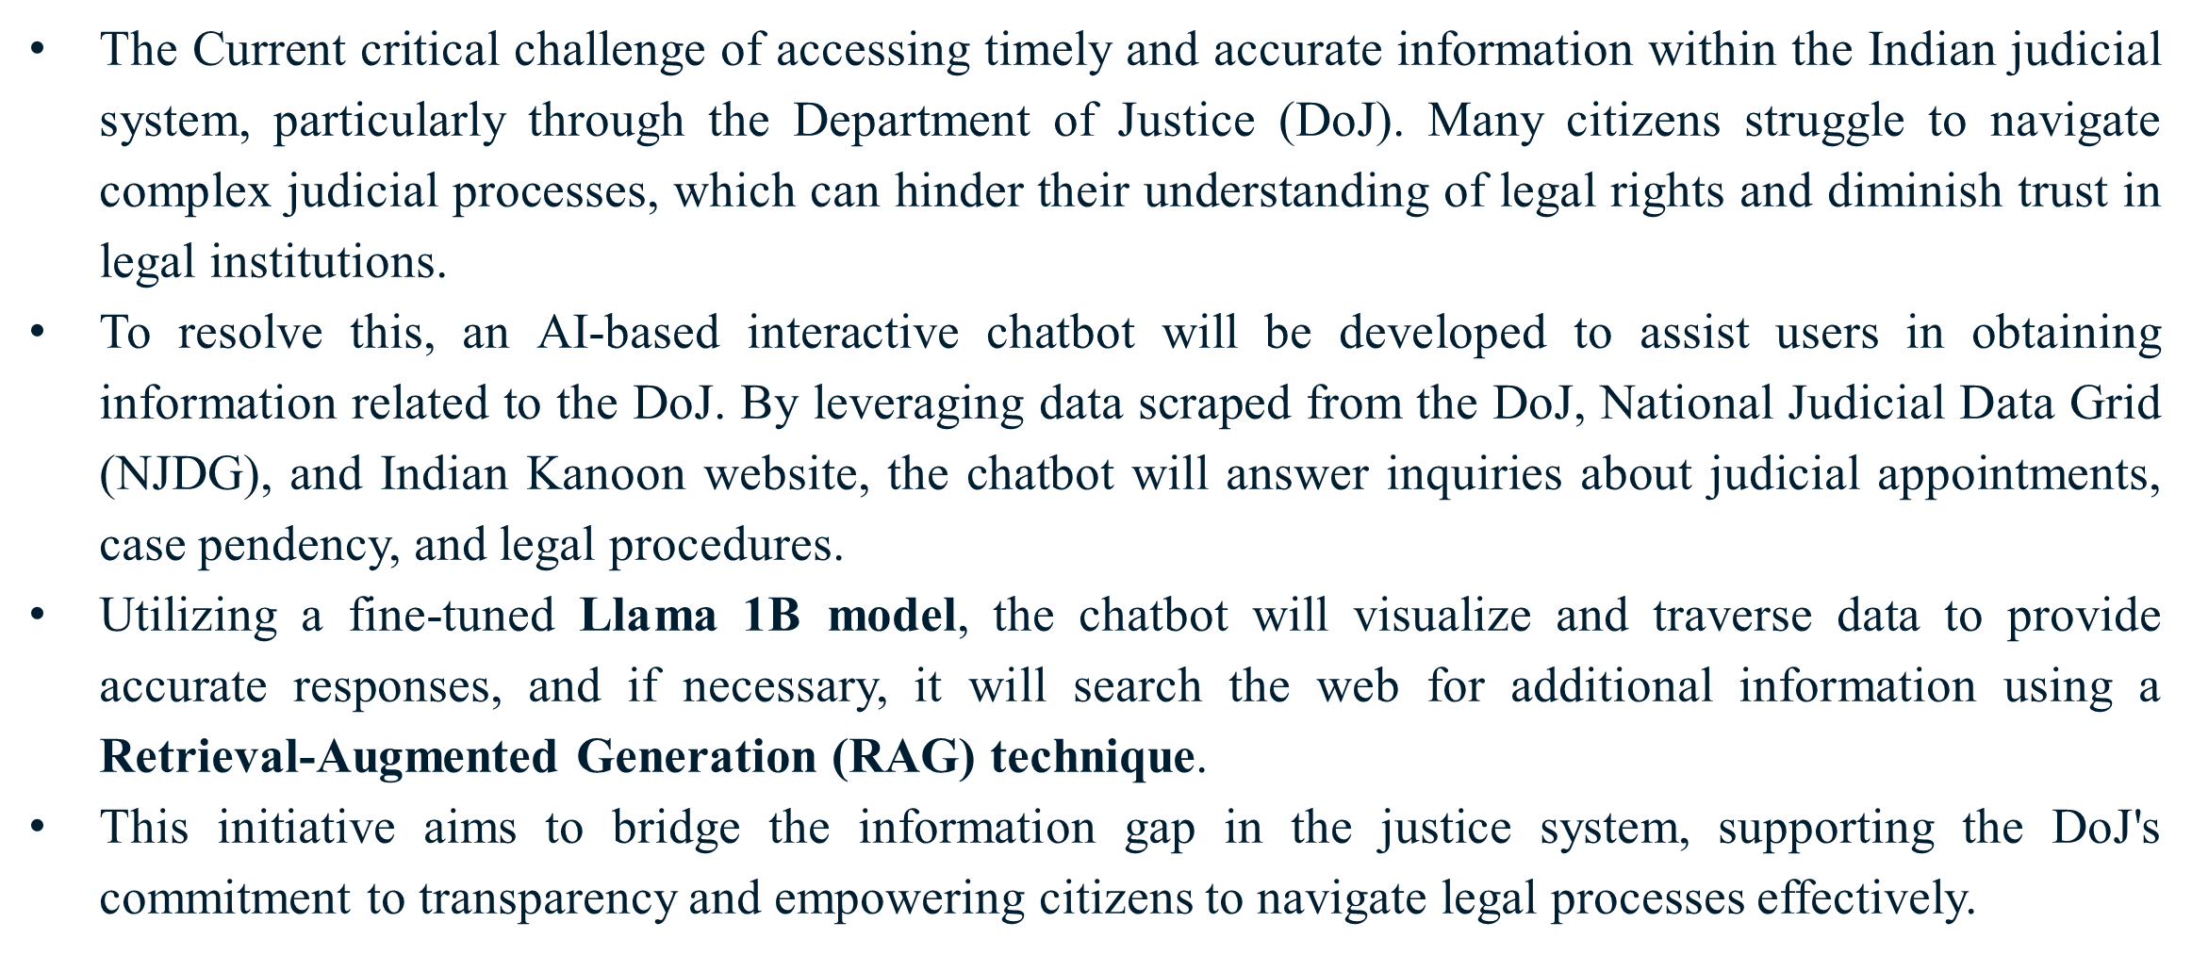
Abstract
pip_
install_
error

Slide 3
Nyaya Sahay - Chatbot
pip_
install_
error
The Department of Justice (DoJ), under the Ministry of Law & Justice, is a critical institution in the Indian legal framework. It is responsible for overseeing judicial reforms, improving infrastructure for the judiciary, and ensuring access to legal aid across the country.
The DoJ is also instrumental in promoting initiatives such as the eCourts Project and Fast-Track Courts to expedite the judicial process and improve the efficiency of the justice system.
Citizens face difficulties accessing timely, relevant, and understandable legal information due to complex judicial processes and overwhelming data.
This lack of accessibility undermines public trust in the legal system and hinders the efficient navigation of judicial procedures.
An AI-powered chatbot will provide a user-friendly, real-time interface for accessing judicial information related to the DoJ.
Using Natural Language Processing (NLP), it will help users easily understand complex legal processes and access critical data quickly.

Slide 4
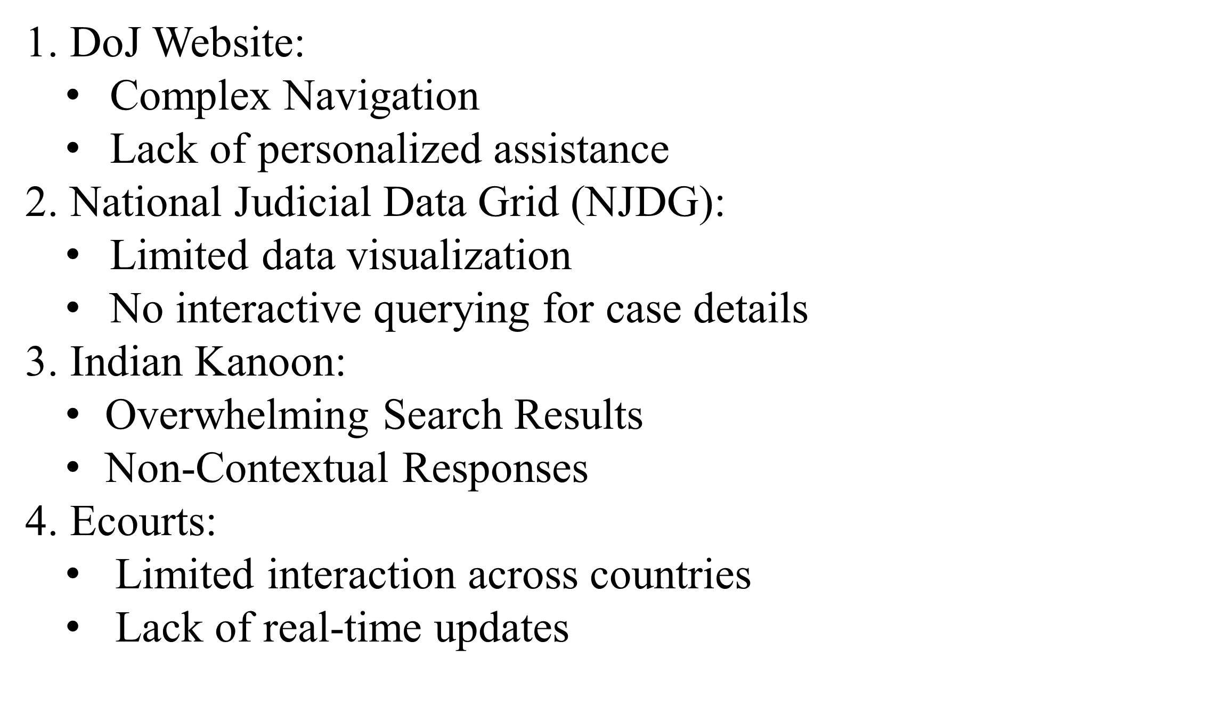
Survey
pip_
install_
error

Slide 5
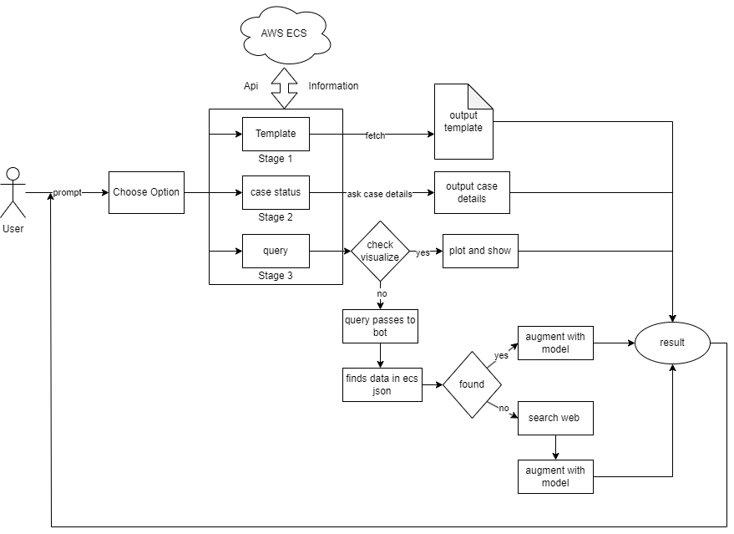
System Architecture
pip_
install_
error

Slide 6
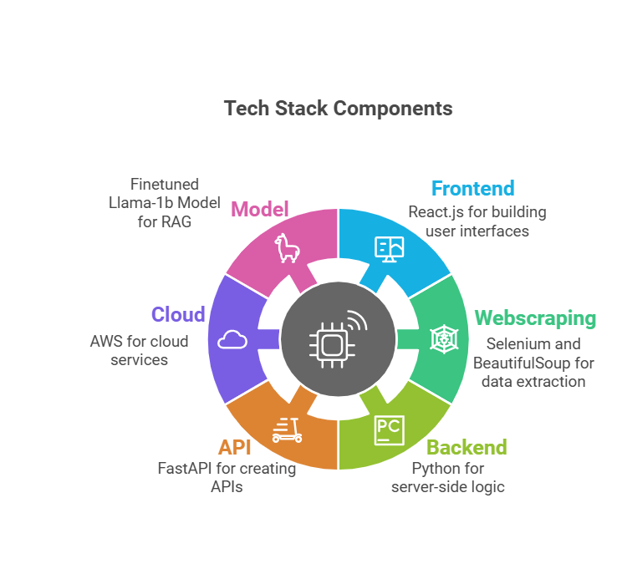
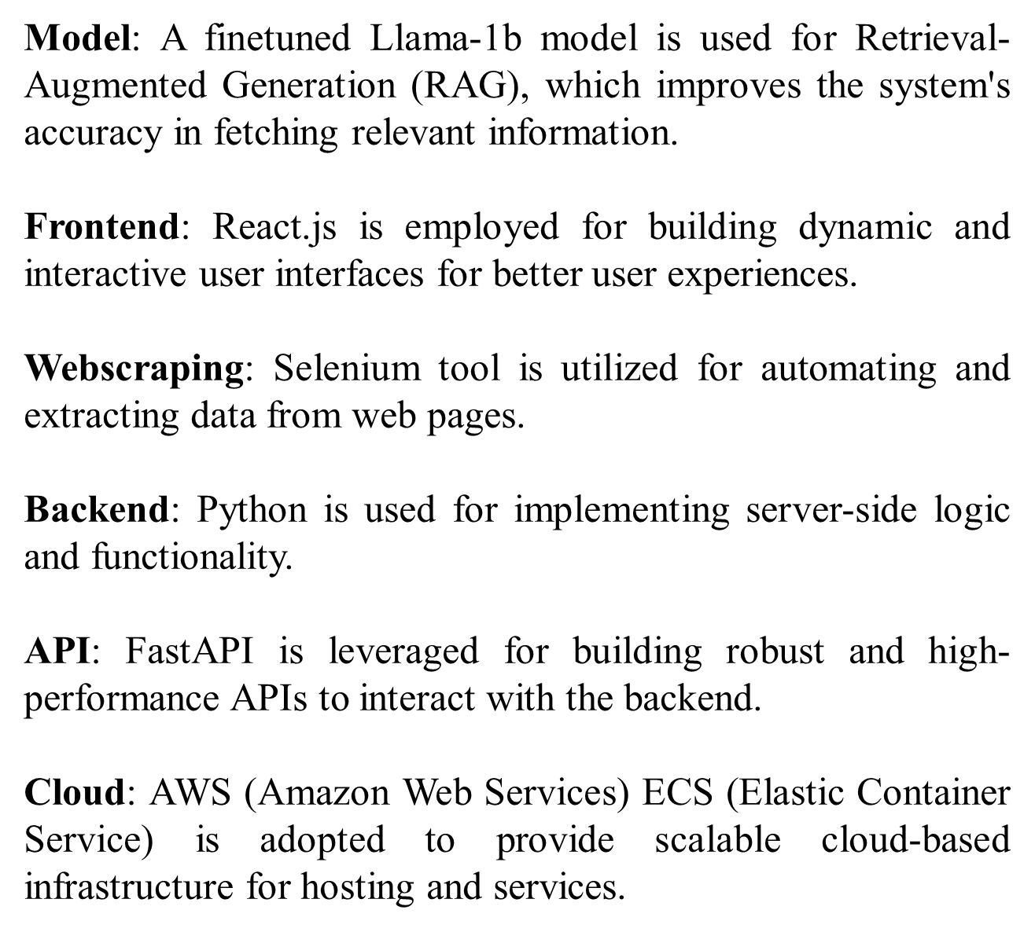
Implementation
pip_
install_
error

Slide 7
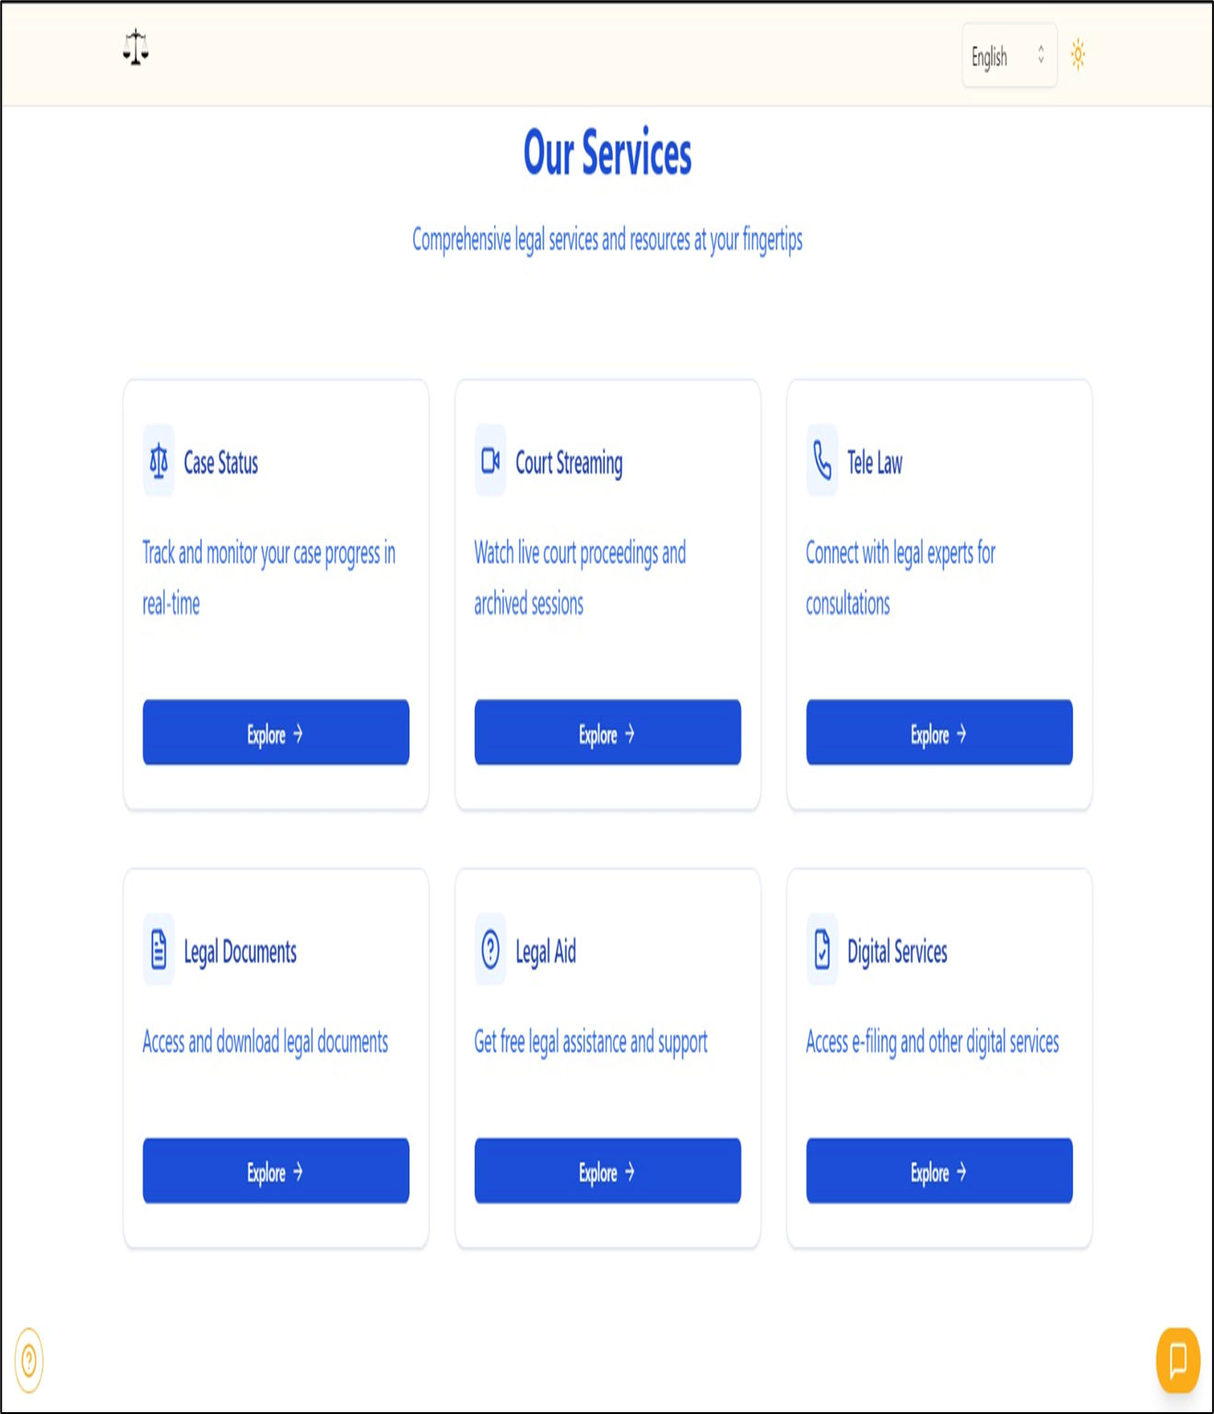
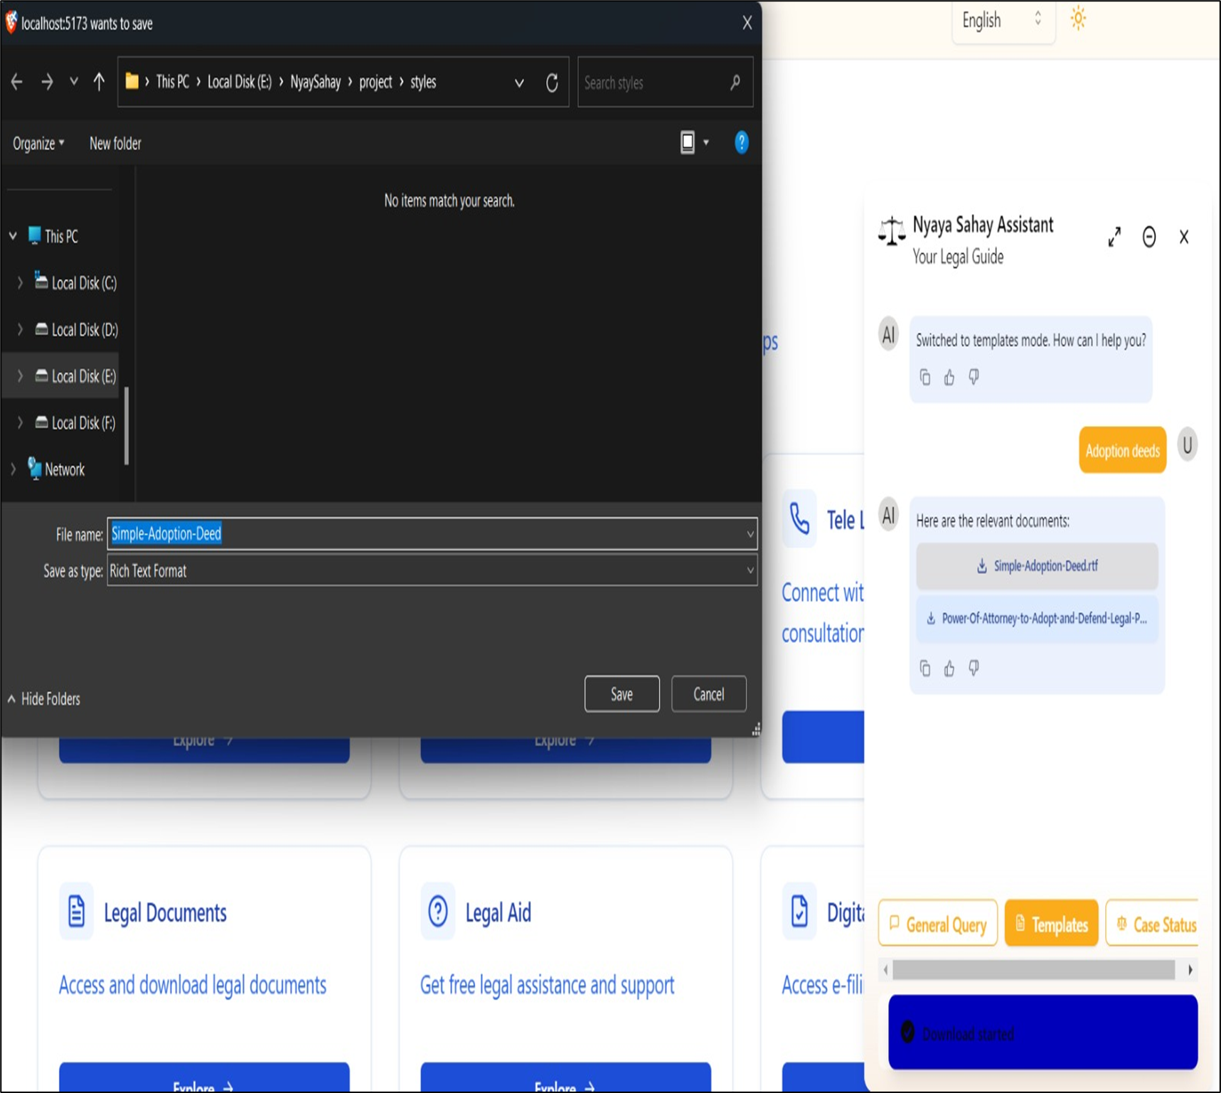
Results of Chatbot
pip_
install_
error
Fig 1. Home page
Fig 2. Document download

Slide 8
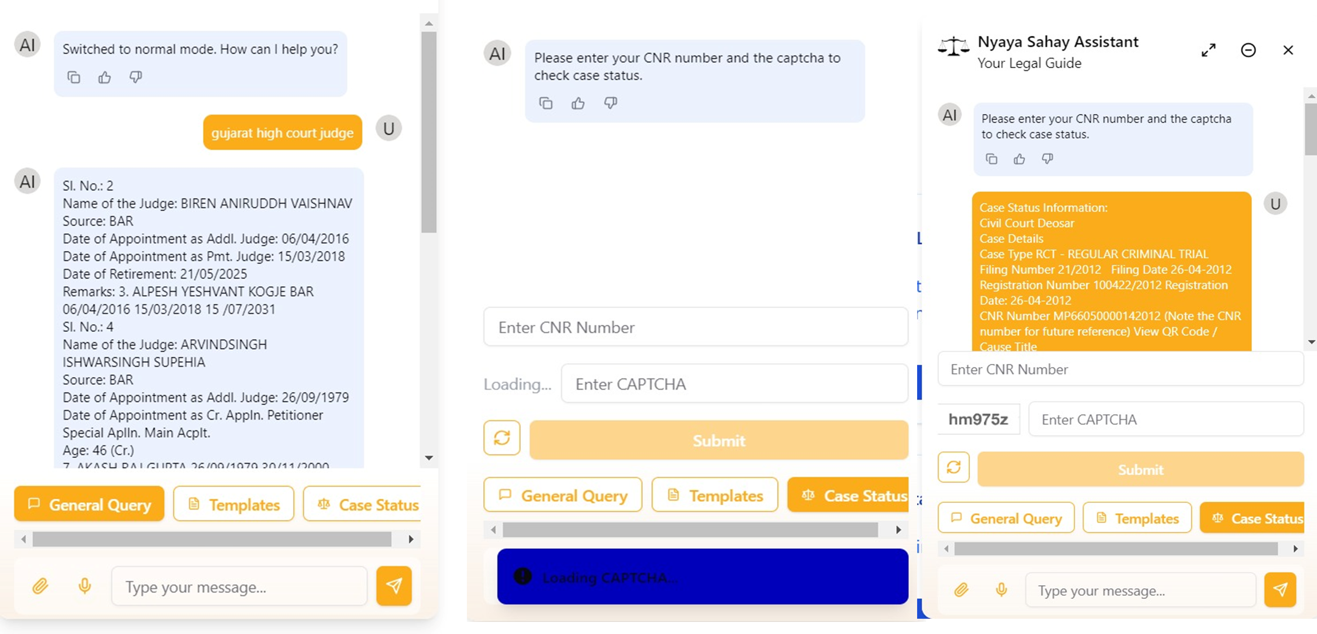
Results of Chatbot
pip_
install_
error
Fig 3. General Query
Fig 4. Case status
Fig 5. Case status output

Slide 9
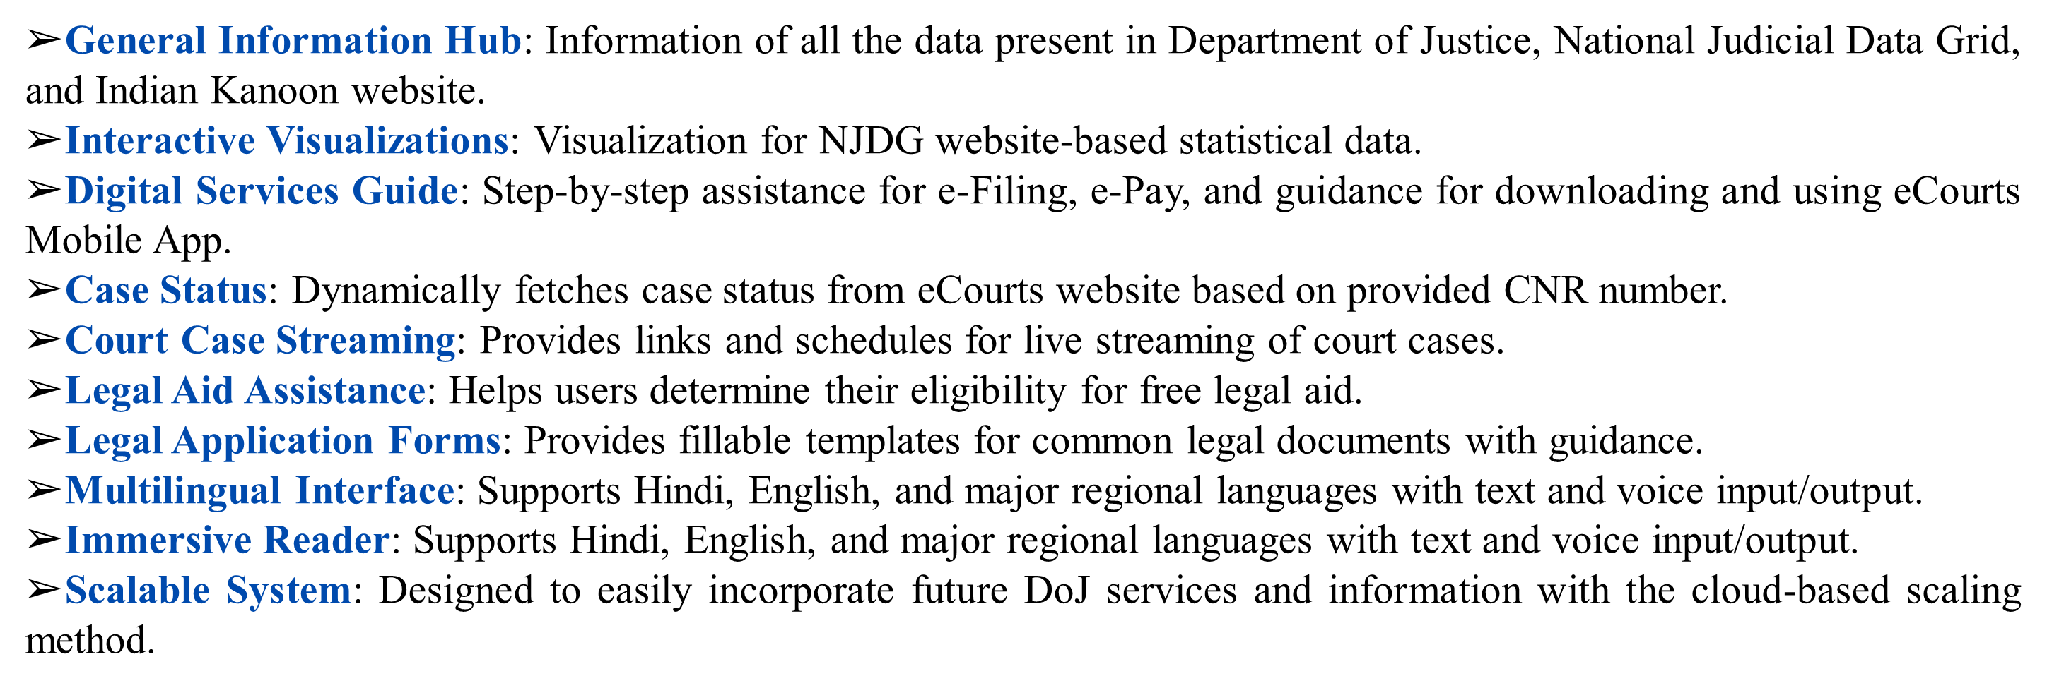
Features
pip_
install_
error

Slide 10
Future Scope
pip_
install_
error
Diversification to more government websites
Enhancing user experience and journey
Legal research engine features
Scaling finetuning-based Retrieval Augmented Generation
Bias Reduction Algorithm

Slide 11
Conclusion
pip_
install_
error
This project leverages AI to create an interactive chatbot for the Indian judicial system, providing citizens with accessible and accurate information on judicial appointments, case status, and legal procedures.
By integrating data from the DoJ, NJDG, and Indian Kanoon, and using advanced technologies like the Llama 1B model and RAG, the chatbot ensures context-aware responses.
Key features include multilingual support, dynamic case status retrieval, legal document assistance, and interactive visualizations.
This initiative enhances transparency, empowers citizens, and aligns with the DoJ's mission to make the justice system more accessible and user-friendly.

Slide 12
pip_
install_
error
Thank
You

